Slide 1
TRAFFIC MANAGEMENT IN NETWORKS USING FUZZY LOGIC

Slide 2
SELF INTRODUCTION
SARANYA.T
(16UG08047)
IDIGA SREEJA
(16UG08013)
PRIYANKA.K.R
(16UG08036)

Slide 3
CONTENT
INTRODUCTION TO PROJECT
OBJECTIVE
PROBLEM STATEMENT
LITERATURE REVIEW
GENERAL ASPECTS AND TECHNOLOGY
IMPLEMENTATION
RESULTS AND DISCUSSIONS
CONCLUSION

Slide 4
INTRODUCTION TO PROJECT
Network traffic management can prevent a network from severe congestion and degradation in throughput delay performance.
TCP encounters various performance problems, when the Internet BDP (Bandwidth-Delay Product) continues to increase.
Examples are the XCP, RCP, JetMax and MaxNet.

Slide 5
OBJECTIVE
The design of a Fuzzy Smoother mechanism that can generate relatively smooth flow throughput.
Using fuzzy logic theory to design an explicit rate-based traffic management scheme (called the IntelRate controller) for the high-speed IP networks.
Used to proactively decide if action should be taken to regulate the source sending rate.

Slide 6
PROBLEM STATEMENT
TCP (Transmission Control Protocol) is a widely deployed congestion control protocol that tackles the Internet traffic.
Their bandwidth probing speed may be too slow when the bandwidth jumps a lot.
The fundamental problem of inaccurate estimation resulting in performance degradation.

Slide 7
LITERATURE REVIEW
1. Network Congestion Control- Managing Internet Traffic:
Author: John Wiley & Sons Ltd., 2005.
Abstract: In the literature, all kinds of methods are applied to solve problems in congestion control.
2. Modified TCP congestion avoidance algorithm:
Author: V. Jacobson
Abstract: Originally TCP was designed for early, low bandwidth, short distance networks, so Standard TCP did not utilize the maximum bandwidth in today’s high bandwidth network environments:

Slide 8
GENERAL ASPECTS AND TECHNOLOGY
Recent studies show that mis-estimation of link bandwidth (e.g., in link sharing networks or wireless networks) may easily occur and can cause significant fairness and stability problems.
A class of explicit congestion control protocols has been proposed to signal network traffic level more precisely by using multiple bits.

Slide 9
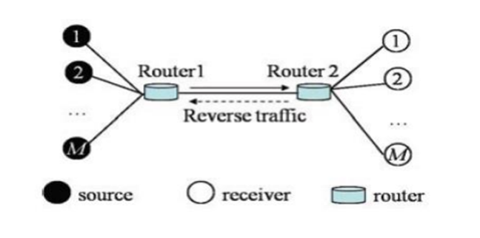
IMPLEMENTATION
SIMULATION SETUP

Slide 10
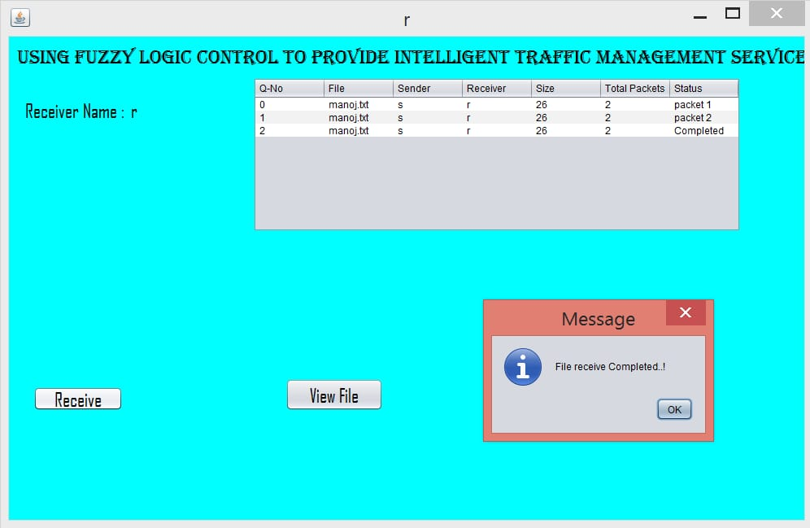
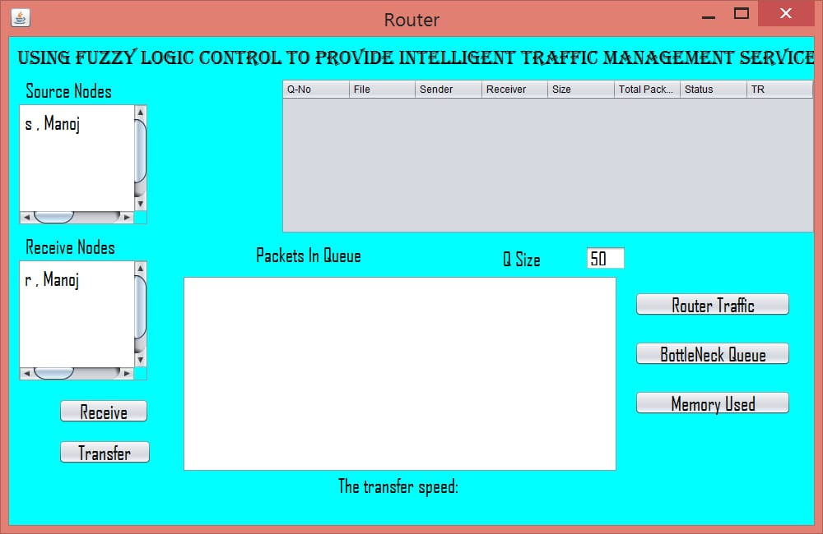
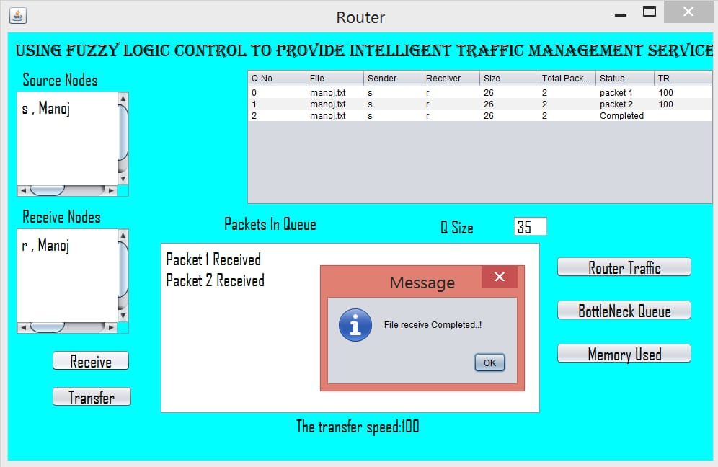
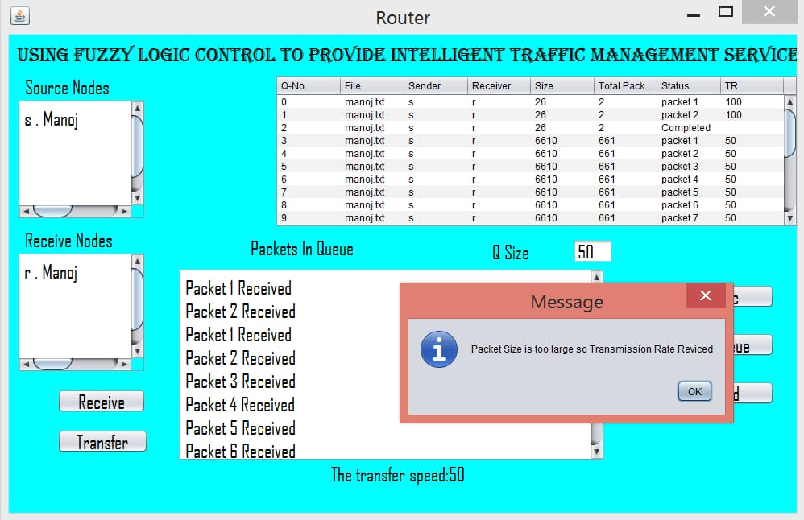
IMPLEMENTATION

Slide 11
RESULT AND DISCUSSION
The queue size can be accurately monitored.
QoS (Quality of Service) is assured by the good performances of our scheme such as max-min fairness, low queueing delay and good robustness to network dynamics.
The controller is designed by paying attention to the disadvantages as well as the advantages of the existing congestion control protocols.

Slide 12
CONCLUSION
A novel traffic management scheme, called the IntelRate controller, has been proposed to manage the Internet congestion in order to assure the quality of service for different service applications.

Slide 13
ANY QUESTIONS?

Slide 14
THANK YOU

